Slide 1

Chapter 2: The Web Like An Essay
Introduction to Web Development
YNC Hacks
Software Track

Slide 2
01
02
03
04
AGENDA
05
METADATA
STRUCTURING HTML
HTML LISTS
HTML LINKS
MULTIMEDIA AND EMBEDDING

Slide 3

Metadata
The head of an HTML document is the part that is not displayed in the web browser when the page is loaded.
Contains things such as the title and favicons

Slide 4
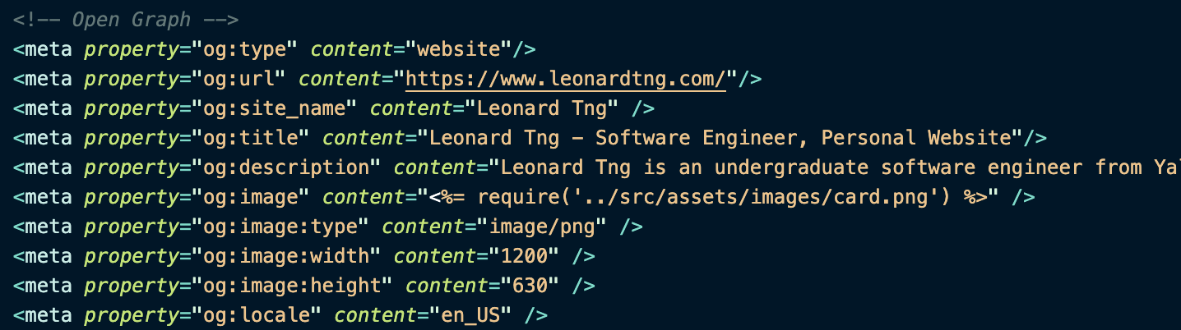
Open Graph Protocol
See it live!

Slide 5
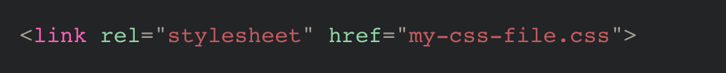
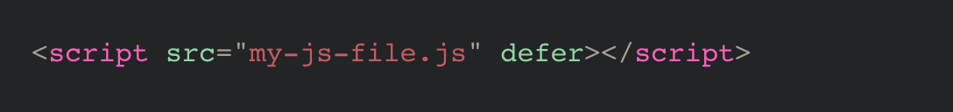
Applying CSS and JS
Link Tag
Script Tag

Slide 6
Structure
Structure is important in HTML: Makes reading easier and enjoyable (like an essay)
Structural Hierarchy

Slide 7

How the Web Works

Slide 8
Basic Sections of A Document
Navigation Bar
<nav>
Header
<header>
Main Content
<main>
Sidebar
<aside>
Footer
<footer>

Slide 9
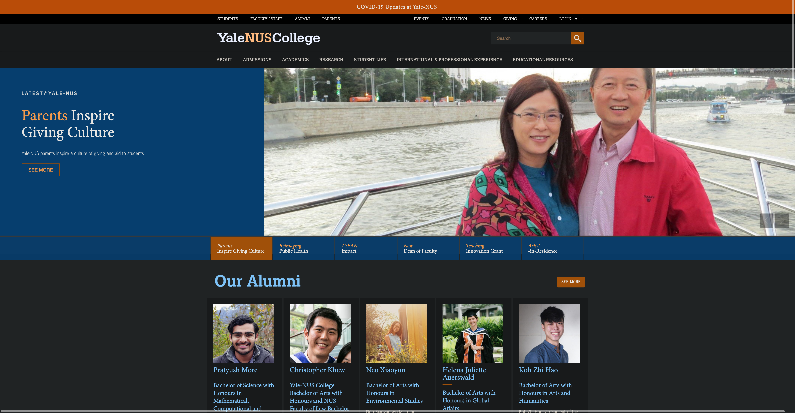

Slide 10
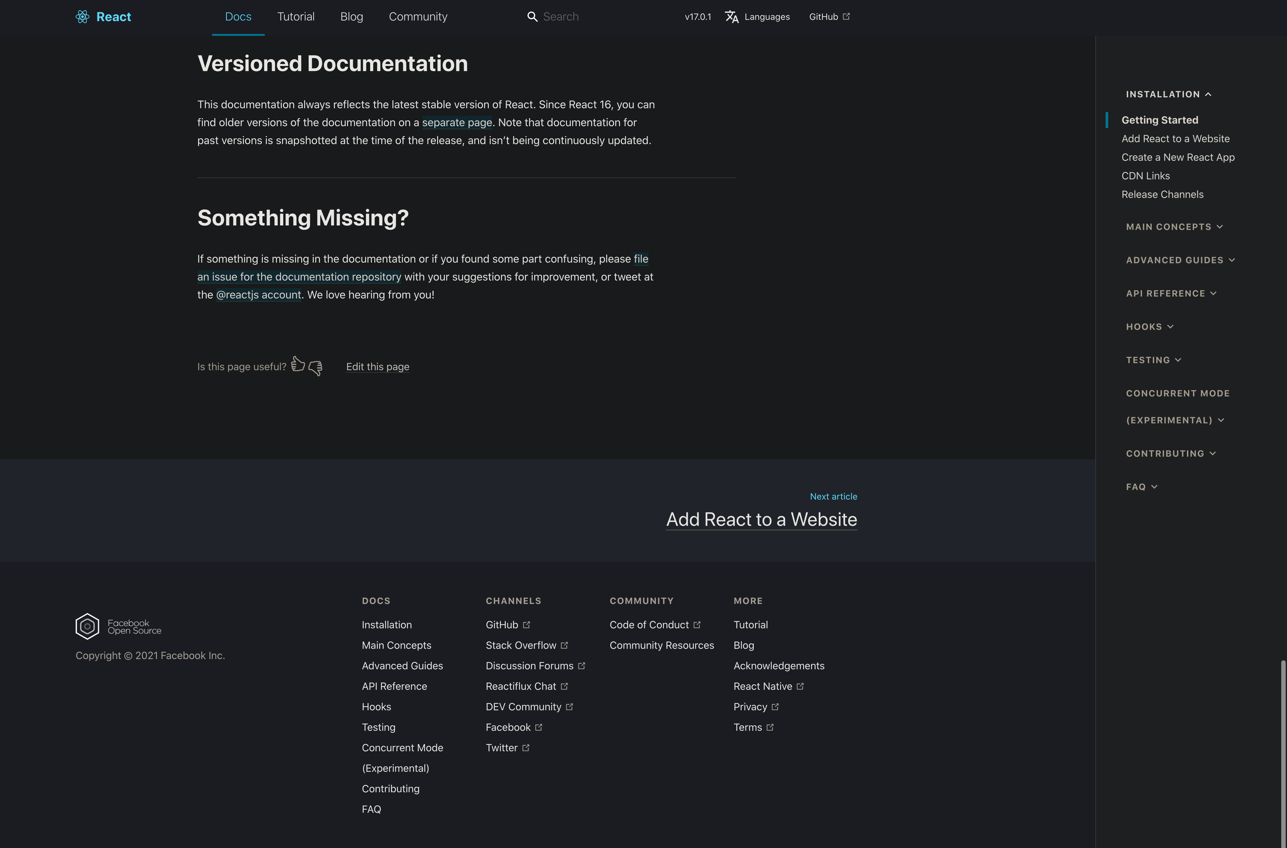

Slide 11

CREATING A HOMEPAGE

Slide 12
PROJECT 2
Welcome
How the Web Works
Setting Up
File Management
Basic HTML
Create a HTML home page!
Ideas:
Personal website
Photo gallery page
Sodexo menu page
Try to include:
Semantic structure, embedding, navigation menu

Slide 13
THANK YOU
Welcome
How the Web Works
Setting Up
File Management
Basic HTML
Repository: https://github.com/leonardtng/introduction-to-web-development
Do you have any questions?
Some content in these slides are adapted from developer.mozilla.org

